Slide 1

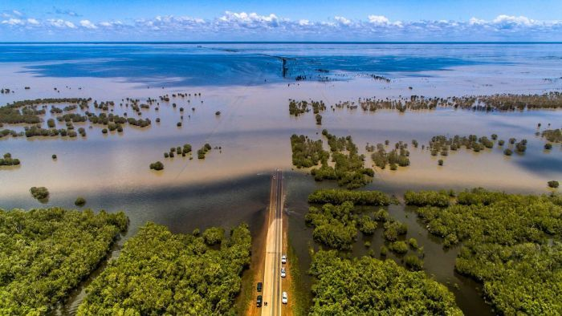
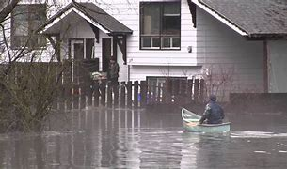
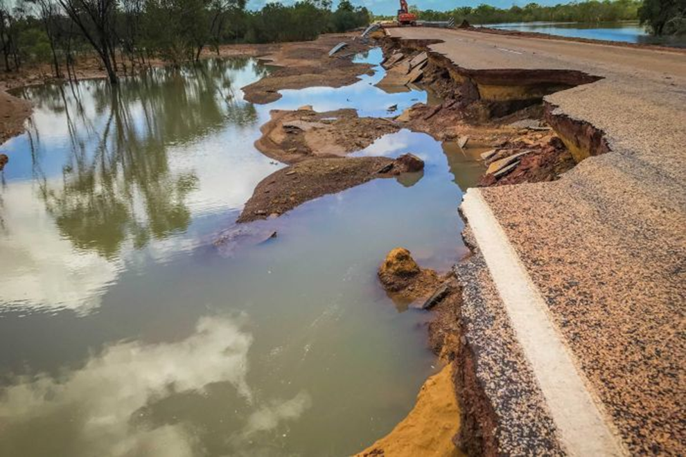
Cyclone Ellie
Kimberly, Australia

Slide 2
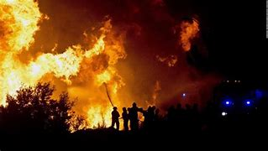
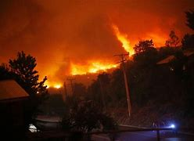
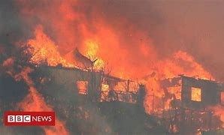
Wildfire
Chile

Slide 3
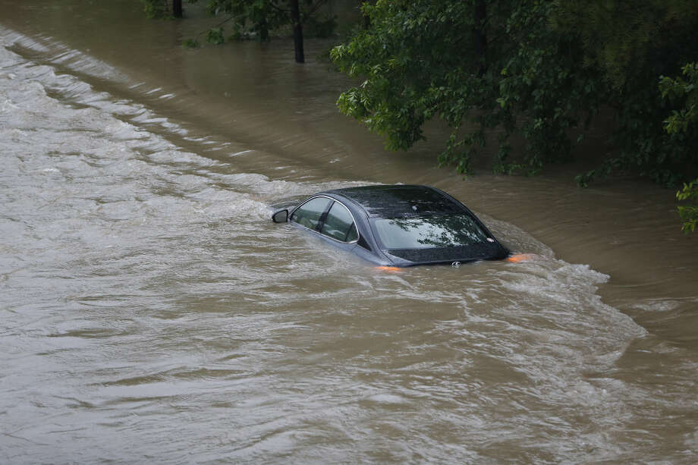
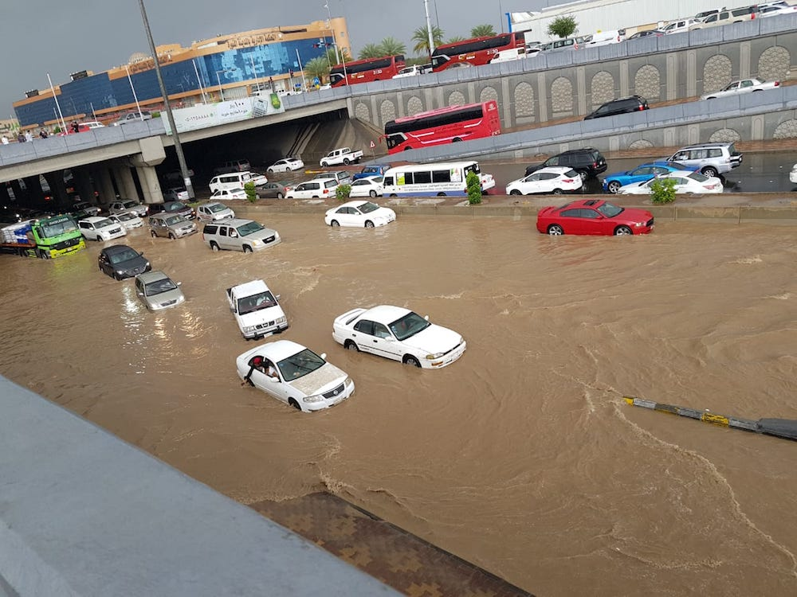
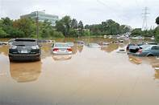
Heavy Rainfall
KSA

Slide 4
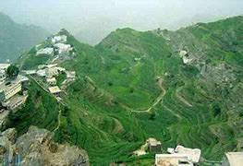

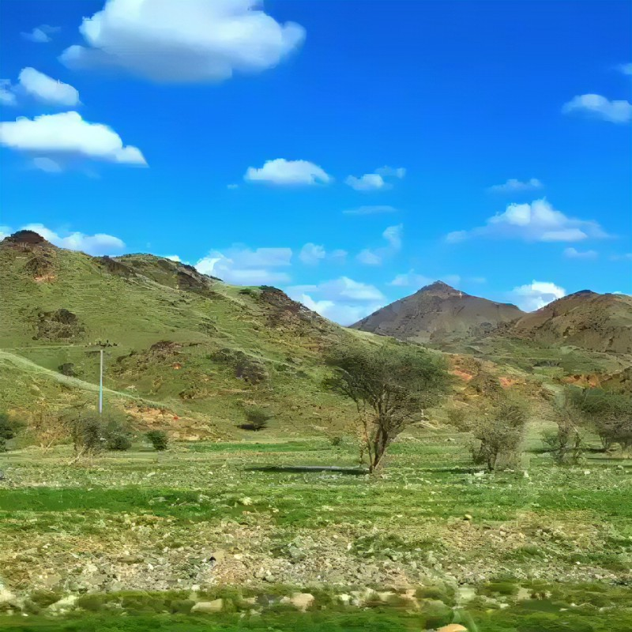
Saudi Arabia
Desert Turned in to green

Slide 5
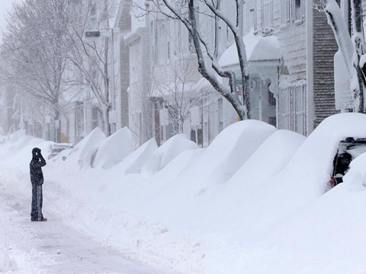
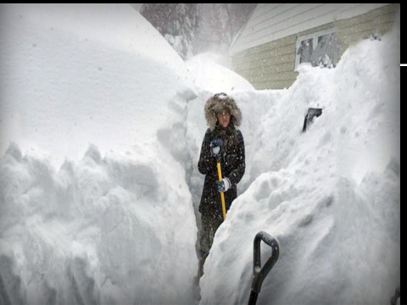
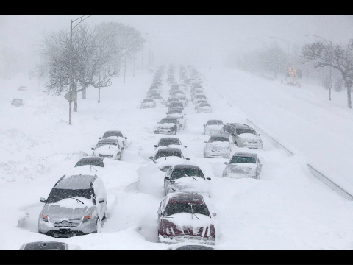
Bomb cyclone
North America

Slide 6
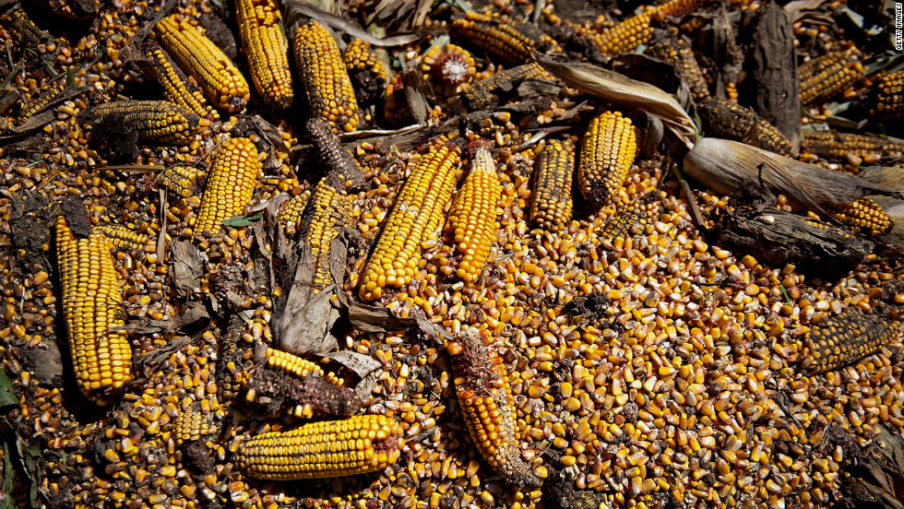
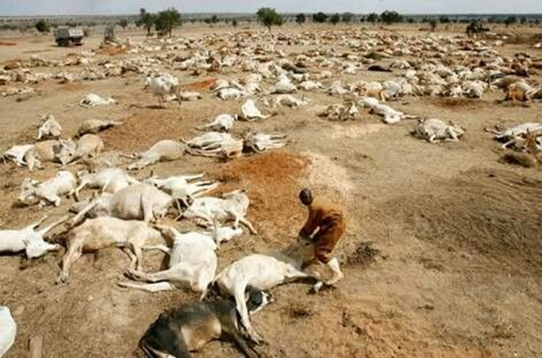
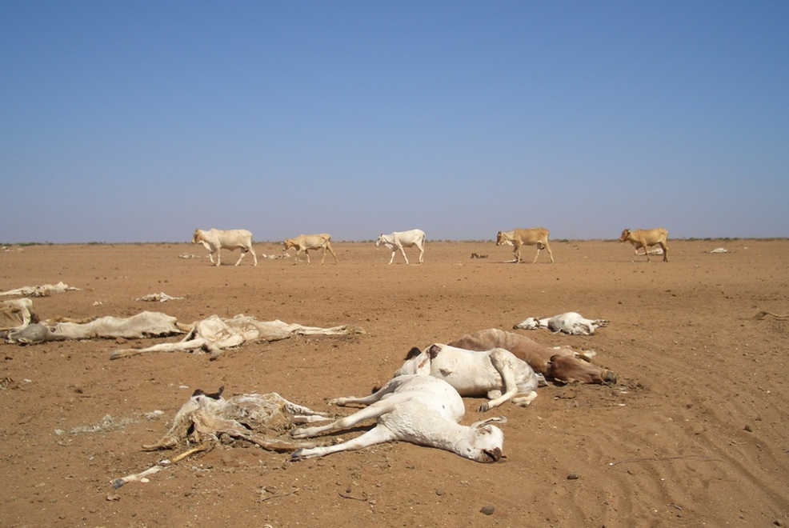
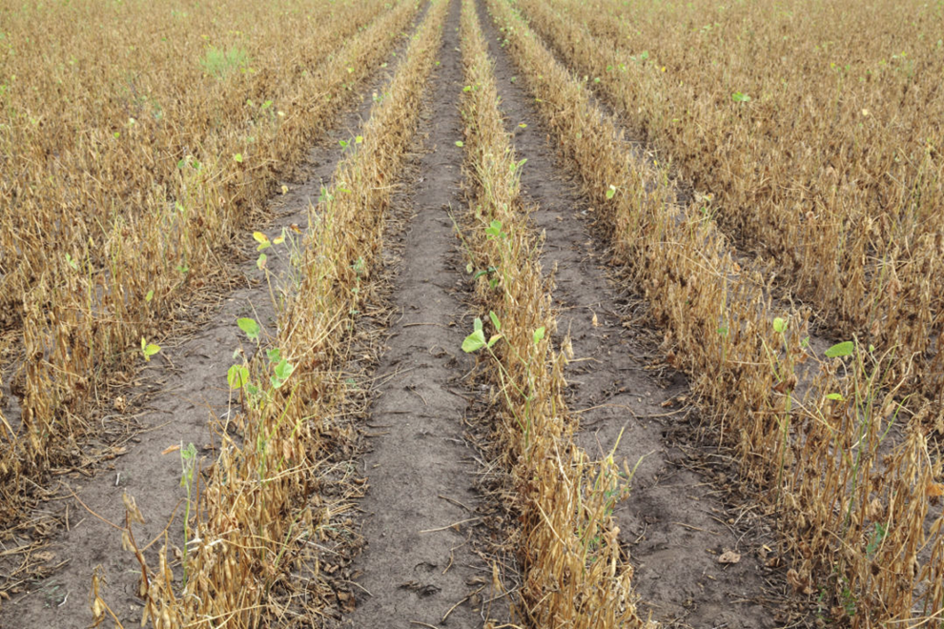
Drought
South America

Slide 7
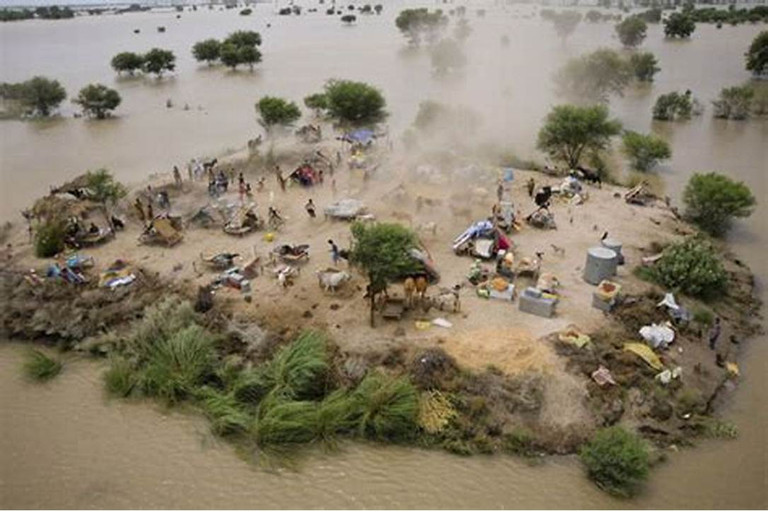
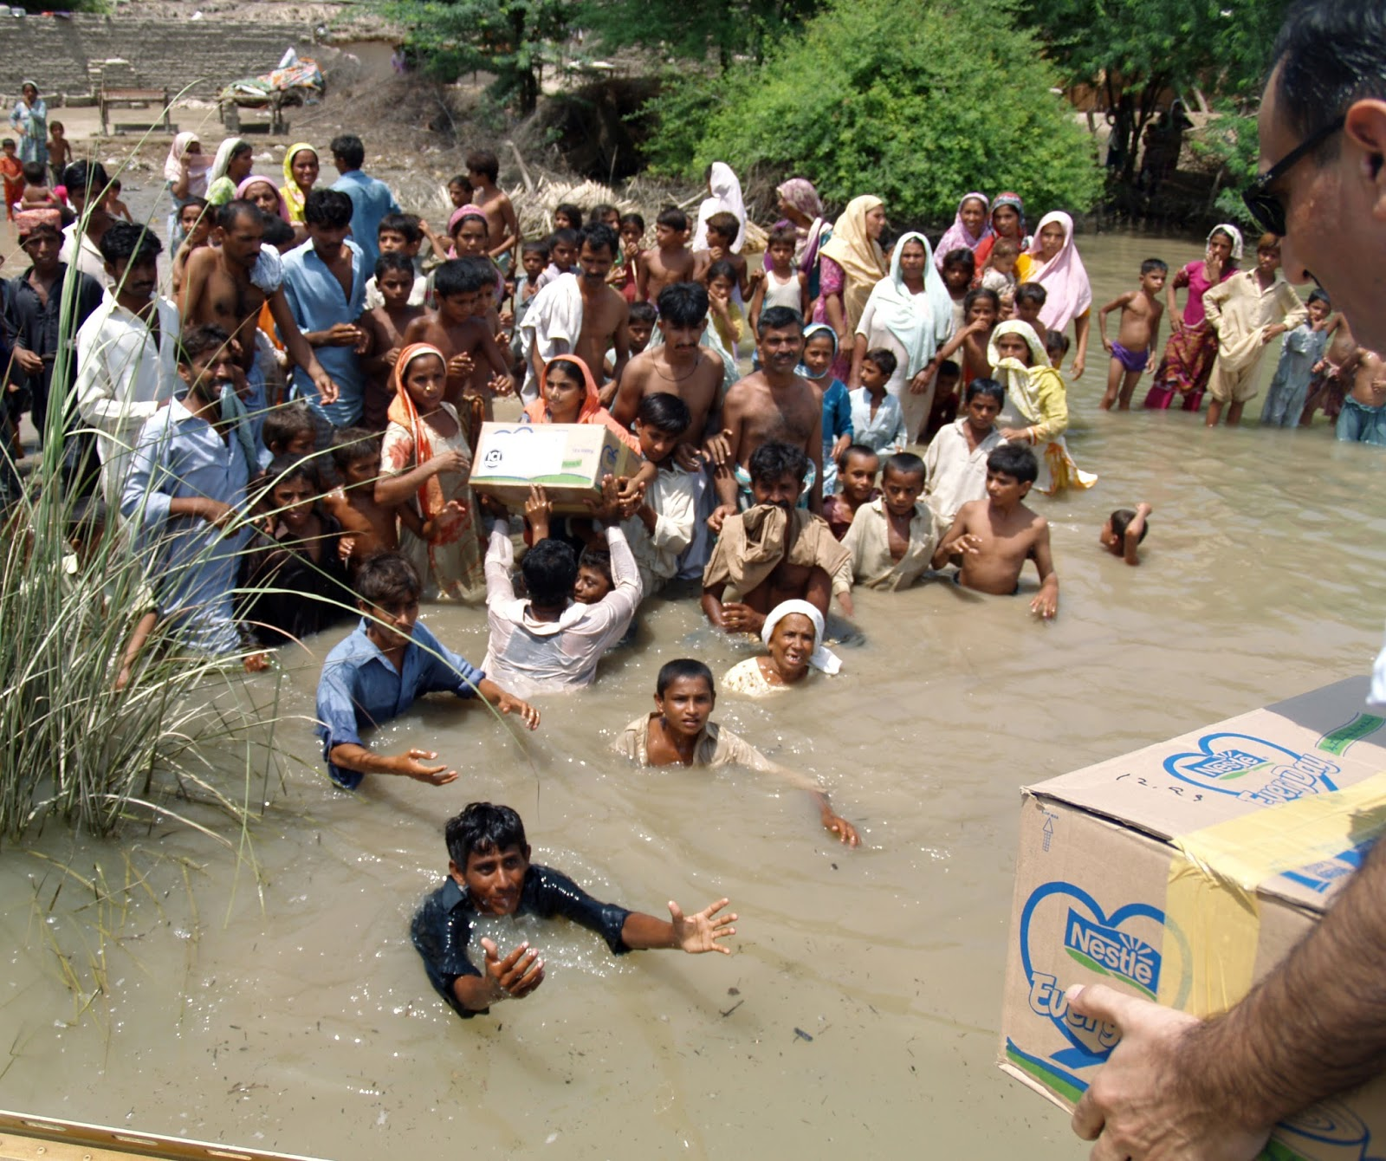
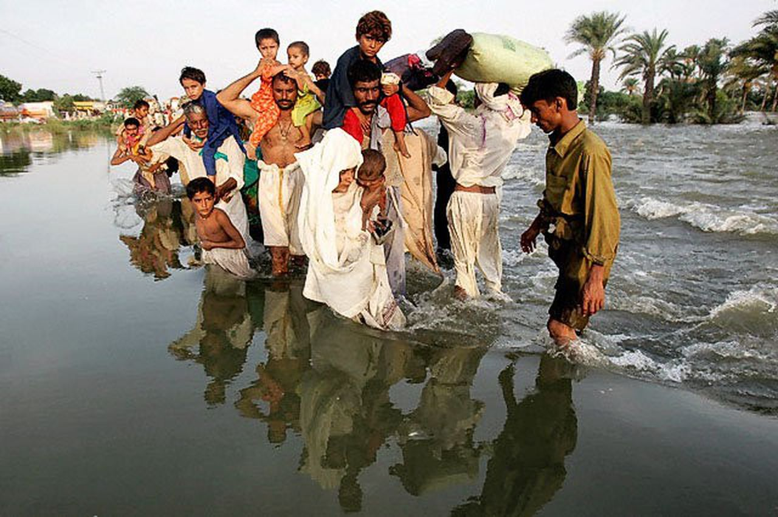
Flood
Pakistan

Slide 8
The Nature is taking it’s revenge to human
as we have destroyed the
NATURE

Slide 9
Climate Change and it’s impact on Human Health
Quazi Tarikul Islam
WCIM 2023, February

Slide 10
Disclaimer
I have no conflict of Interest
No financial involvement

Slide 11
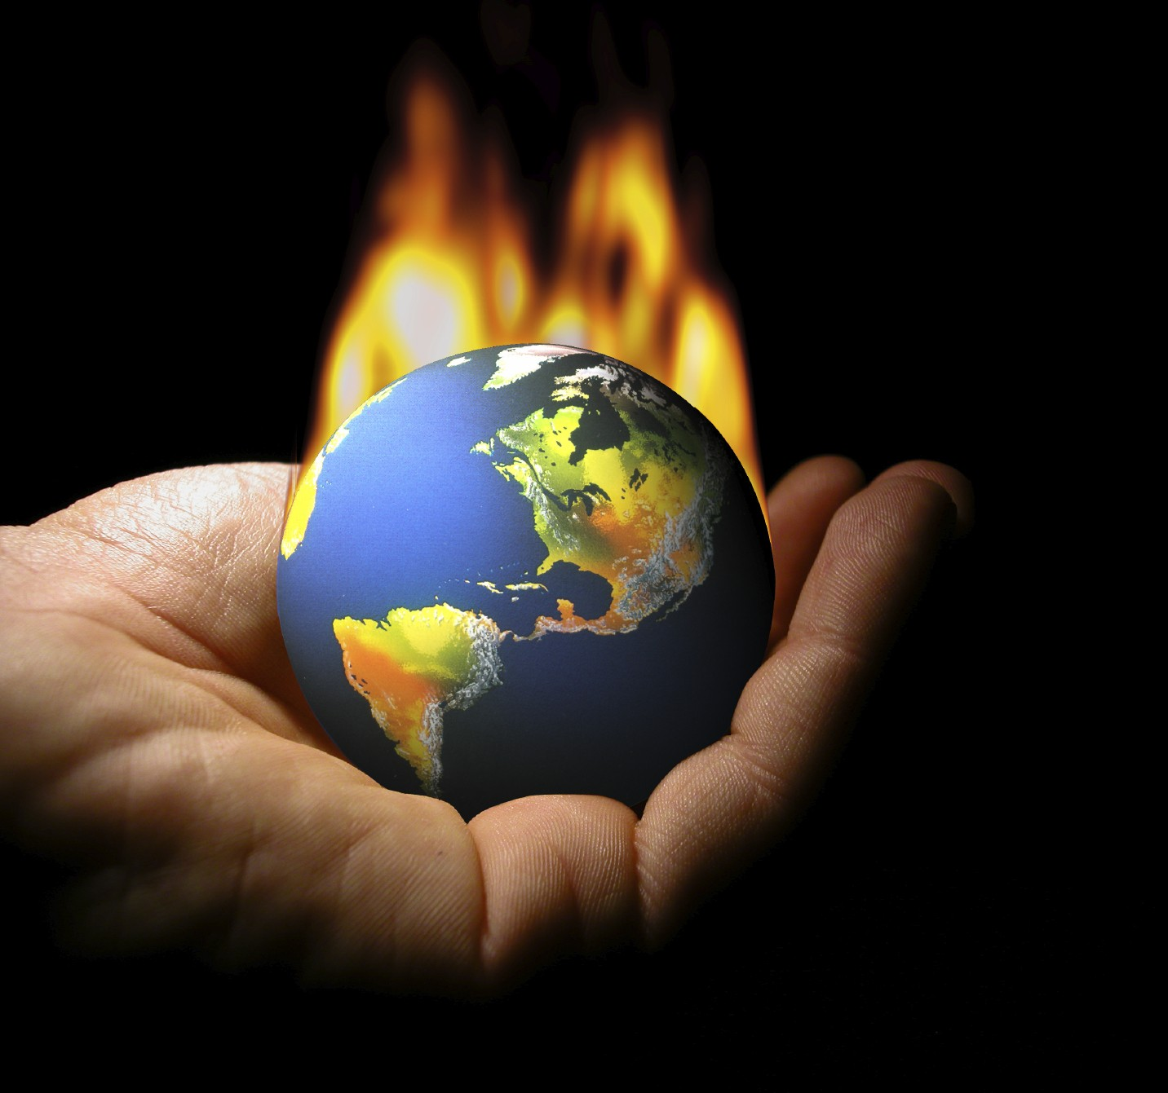

Slide 12
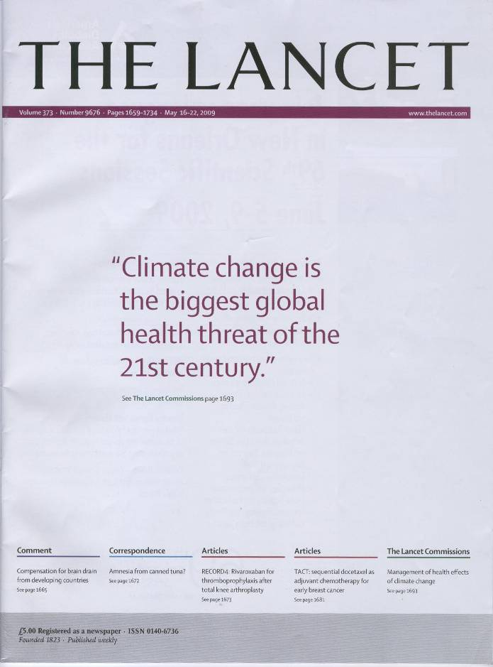
Lancet/UCL Commission, May 2008

Slide 13
Lancet Countdown
The 2022 report of the Lancet Countdown on health and climate change: Health at the mercy of fossil fuels

Slide 14
Introduction
Definition of climate change
Climate change is happening
Green House Gasses
Health Impacts
Heat
Heat Wave
Warming
Health and extreme weather events
Land and climate related hazards
Climate suitability for infectious disease transmission
Food security and undernutrition

Slide 15
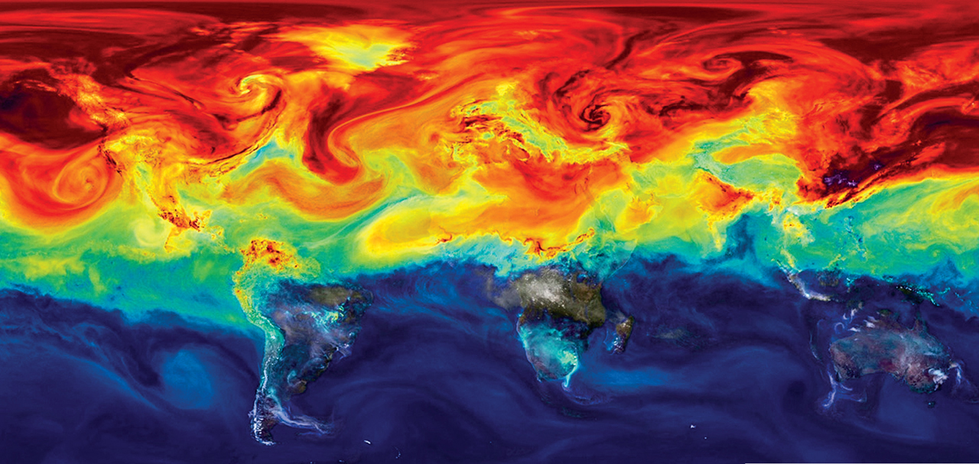
What is climate change?
According to World Health Organization (WHO), Climate change refers to long-term shifts in temperatures and weather patterns. These shifts may be natural, such as through variations in the solar cycle.
The United Nations Framework Convention on Climate Change (UNFCC) defines climate change as a change which is attributed directly or indirectly to human activity that alters the composition of the global atmosphere and an addition to natural climate variability observed over comparable time periods.

Slide 16
climate change: Basic issues
Variety of cosmological and geological processes.
“Climate change” refers to an additional, and relatively rapid, change induced by human actions.
The additional change – several degrees C within a century – will disrupt the foundations of life on Earth.
Ecosystems and life in general have evolved within a narrow band of climatic-environmental conditions.

Slide 17
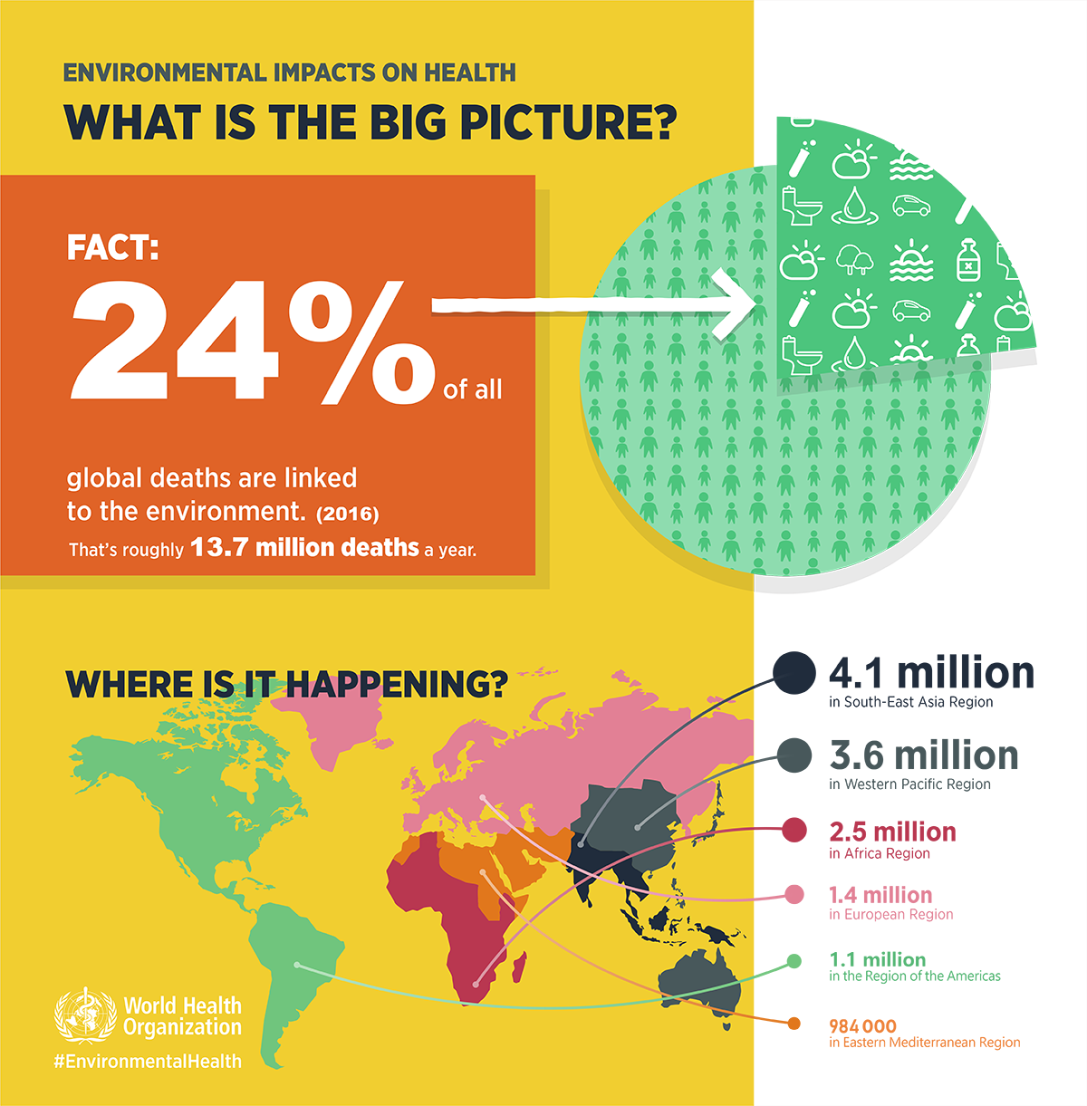
Effect of
Climate Change in Regions

Slide 18
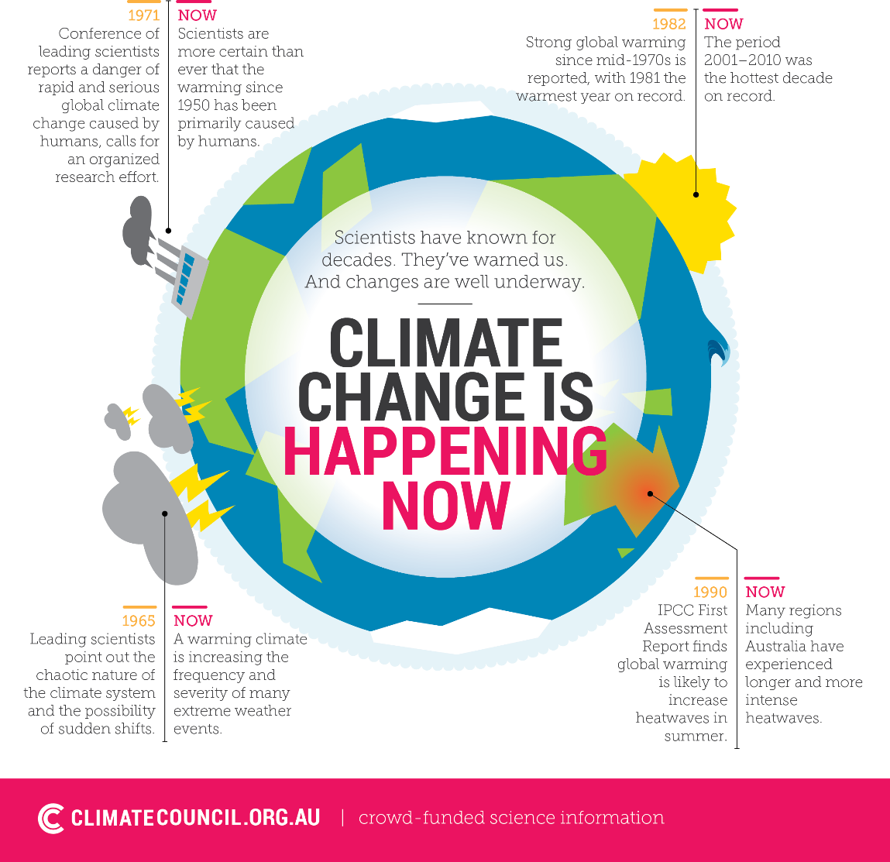

Slide 19
climate change is happening now
In the last 300 years, the worlds population increased by 12 times.
Energy used in 50 years (1970-2020) raised by 3 folds.
7 billion people of the world are using 1/3rd of land for grazing and crops by removing natural vegetation.
De-forestation of 5-6 million hectors of land per year (0.5%) is happening.

Slide 20
Global addiction to fossil fuel: coal, oil and gas very cheap, very useful and very dangerous
We have been releasing 350 million years-worth of carbon locked away in fossil fuels in 160 years
160 years
100 years
60 years
NOW
First Oil Well
4000 cars in USA
First commercial jet ticket
600,000,000 cars
4,000,000,000 passenger flights
Notes:
The earth absorbed huge quantities of carbon dioxide into fossil fuel deposits in the carboniferous period – it took about 160 million years within that period to reduce it to levels which support today’s level of life – we have unlocked a significant proportion of this carbon in 160 years.
We have already released well over 500 billion tonnes of carbon into the atmosphere over h. We are set to burn the next 500 billion in 40 years. That will exceed the trillion tonnes carbon budget that will tip us into dangerous climate change (over 2 degrees etc...).
If we limit the emissions to less than a trillion tonnes, then we stand a 25% chance of avoiding dangerous climate change. That means taking significant action at all levels now.
-----------------
In 2003 heatwave, 35,000 people died prematurely in Europe, 2000 of them in London in 10 days – and nobody even realised until several weeks afterwards [I can supply reference]
Health professionals and the NHS are widely respected and trusted
There are many immediate benefits too (“co-benefits”) by changing how we move (active travel) and what we eat (less meat/dairy), and how much attention we pay to e.g. helping our patients improve their home insulation.
-------------------
“Humanity's carbon budget set at one trillion tonnes.” New Scientist, 29 April 2009

Slide 21
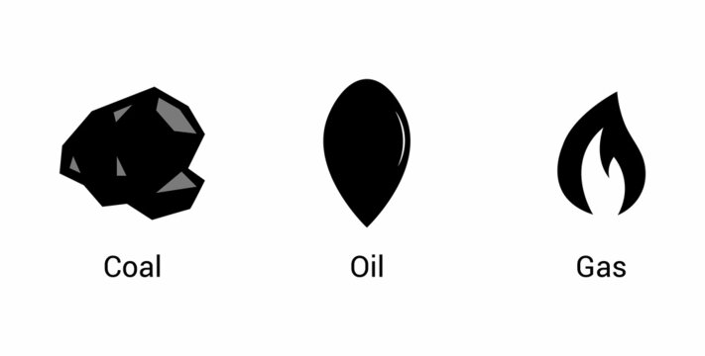
Carbon emission
196,442 kg of coal
150,179 litres of oil
103,881,279 litres of gas
…….. IN A SECOND!

Slide 22
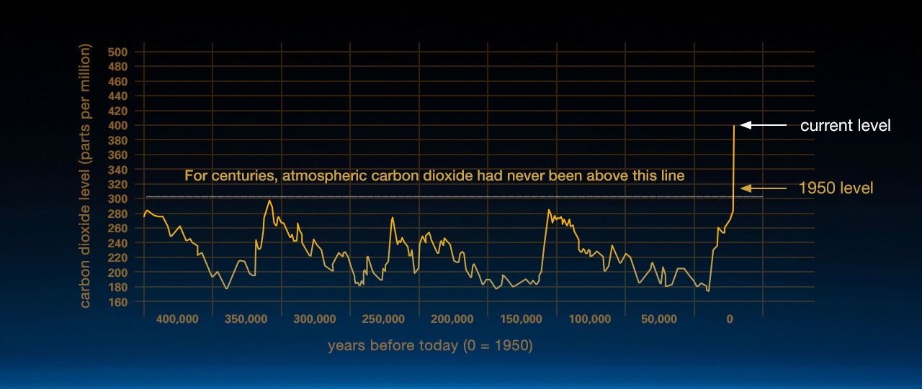
Carbon Emission

Slide 23
Flows of emissions of CO₂ from burning fossil-fuels have risen rapidly since 1950
Billions of tonnes of CO2
Notes:
Half of human greenhouse gas emissions have been since 1973!!! They last a long time, too: 1/5 will still be in the atmosphere, warming us, in 33,000 years time.

Slide 24
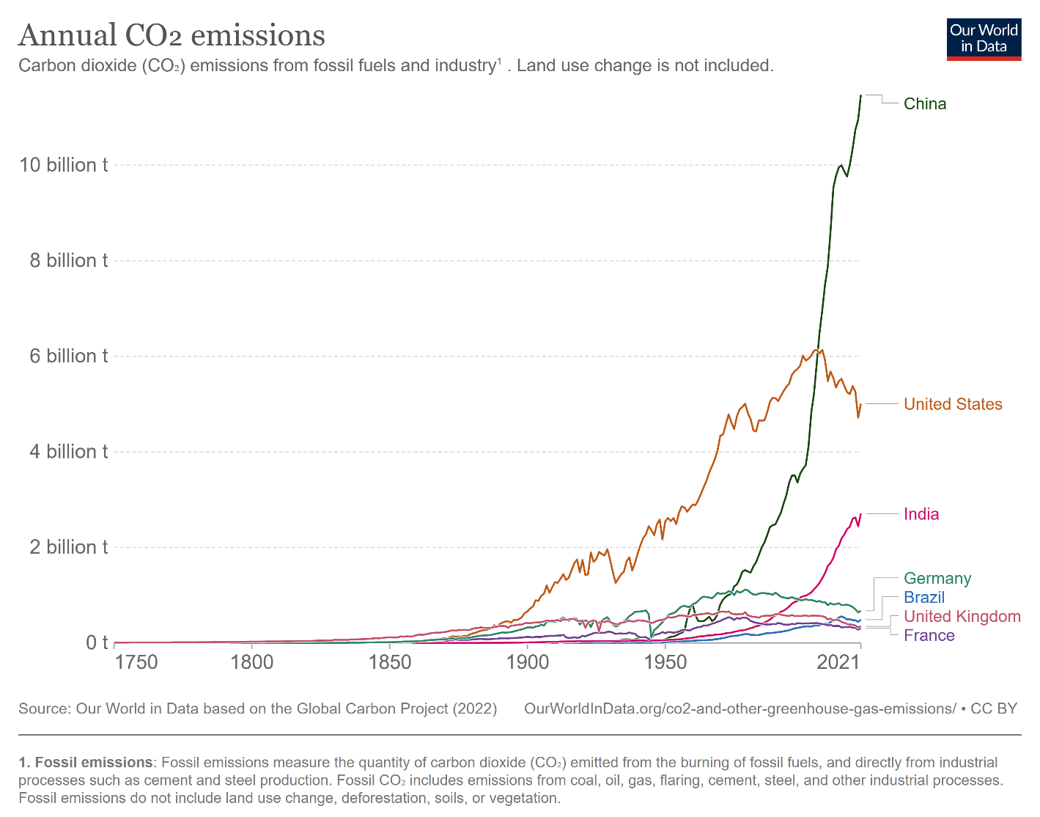
Annual Carbon Emissions

Slide 25
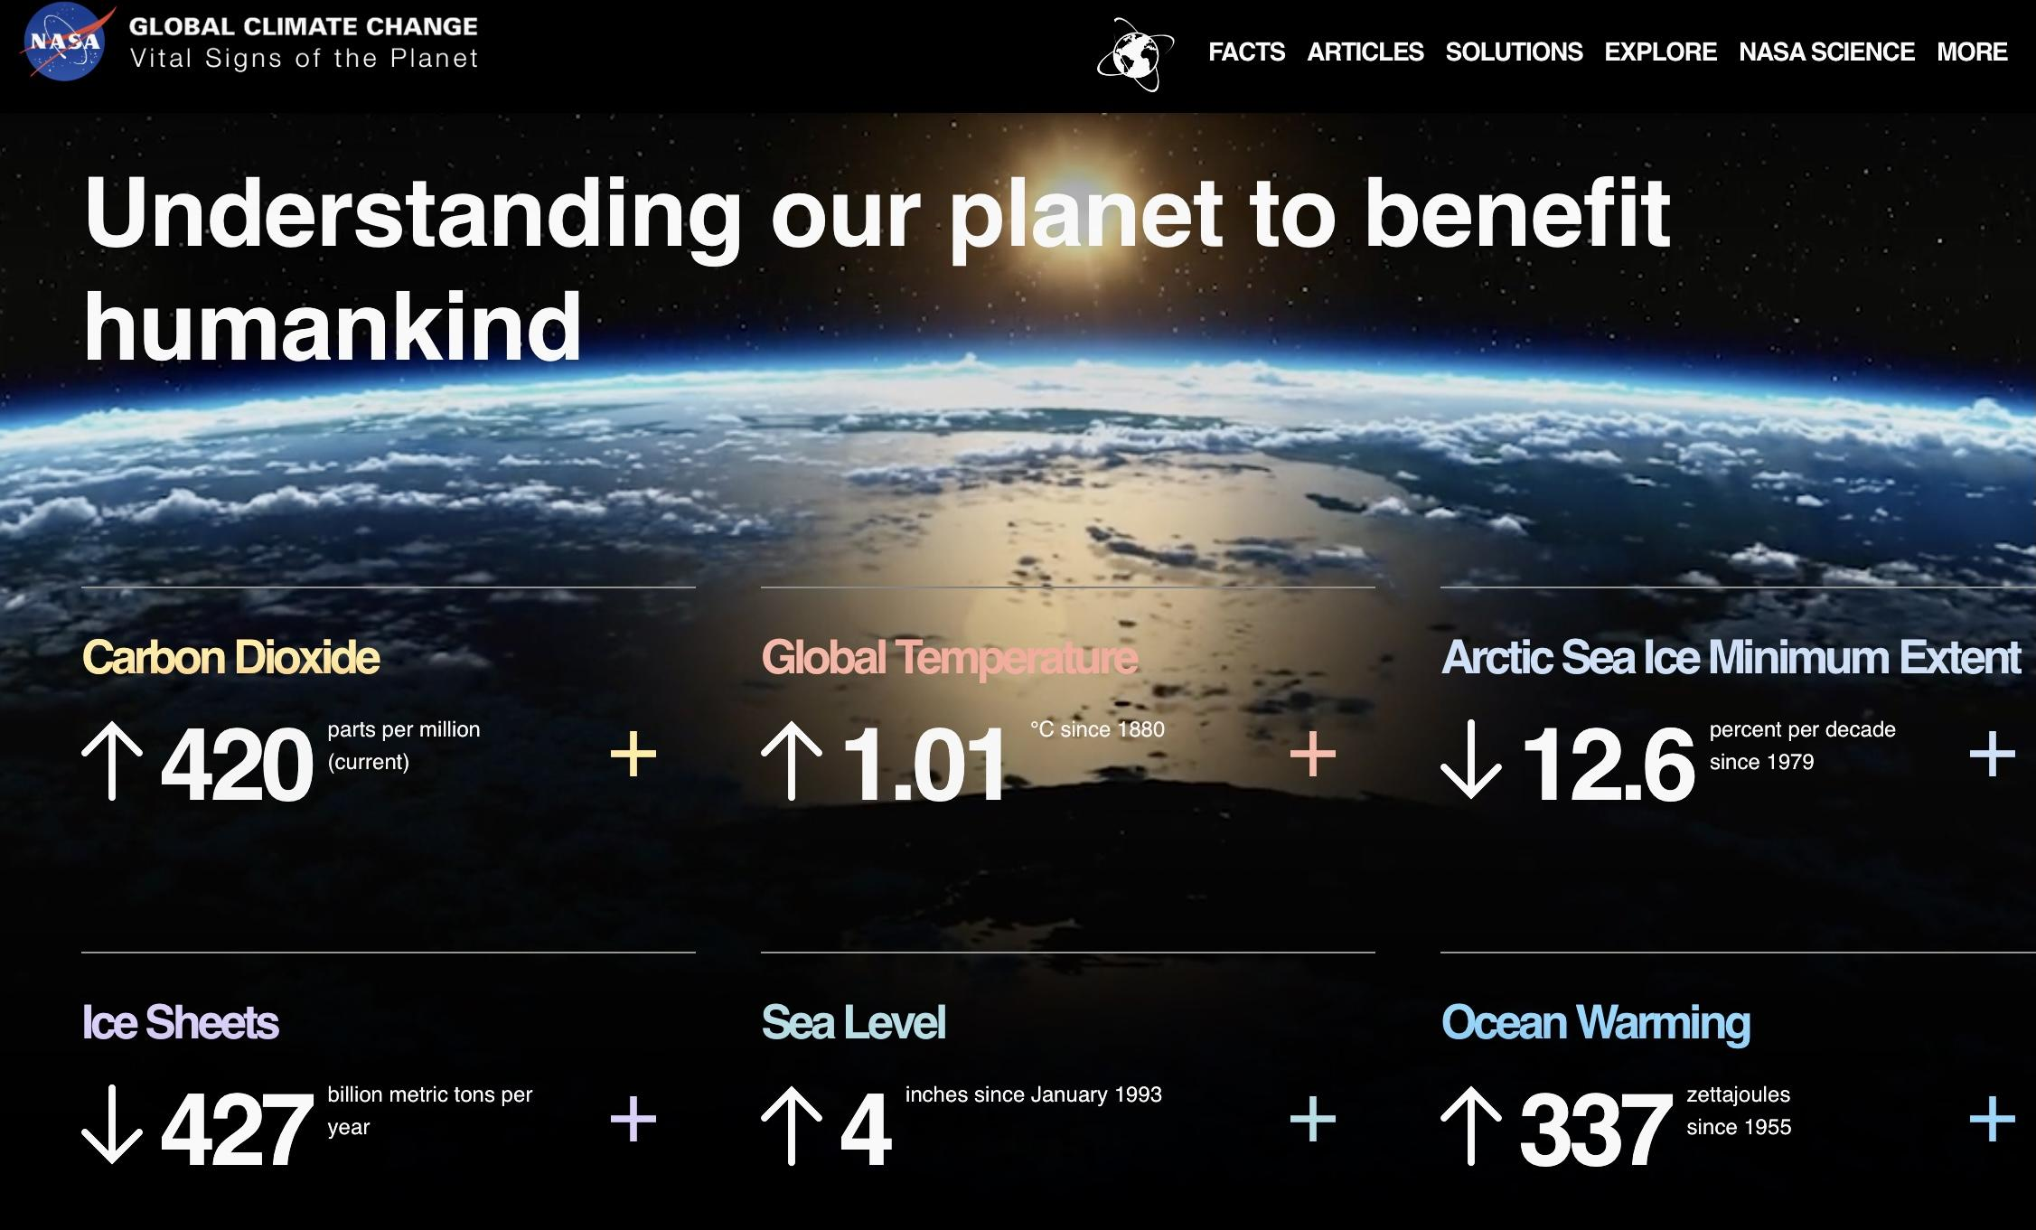
Climate change : How do we know?

Slide 26
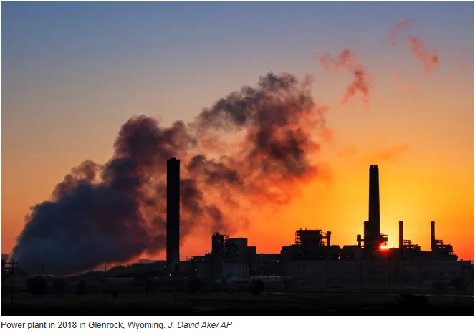
Industrial carbon emission

Slide 27
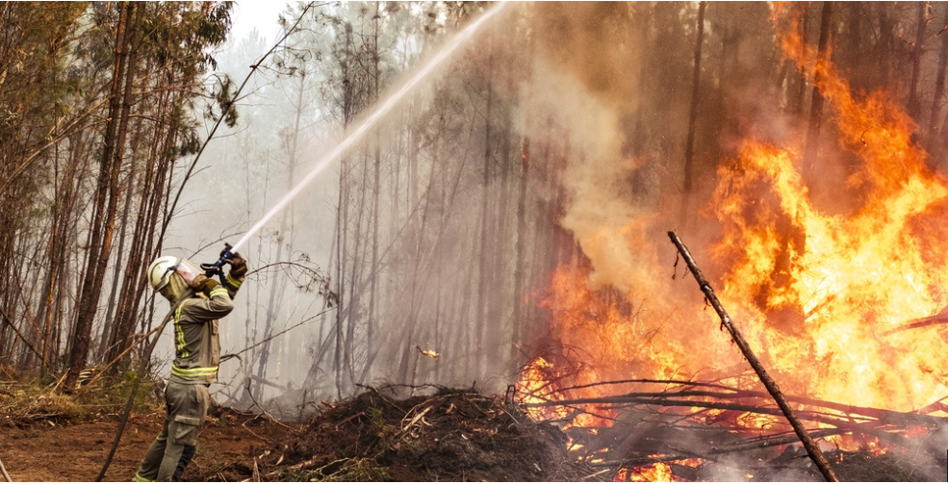
Wild Fire

Slide 28
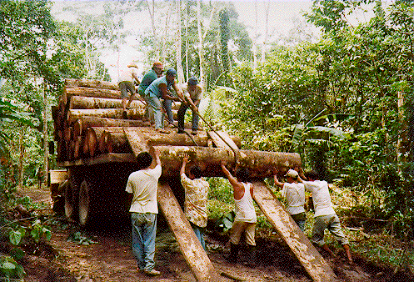
DEFORESTATION
Reduce Ability of Ecosystem to Absorb Greenhouse Gasses

Slide 29
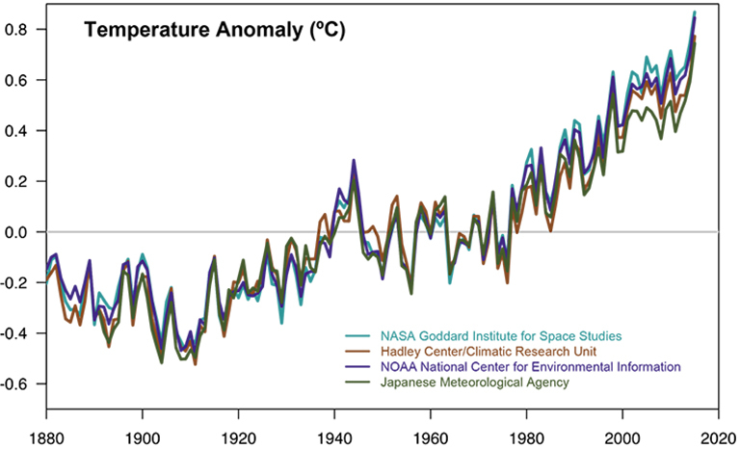
Increasing Temperature

Slide 30
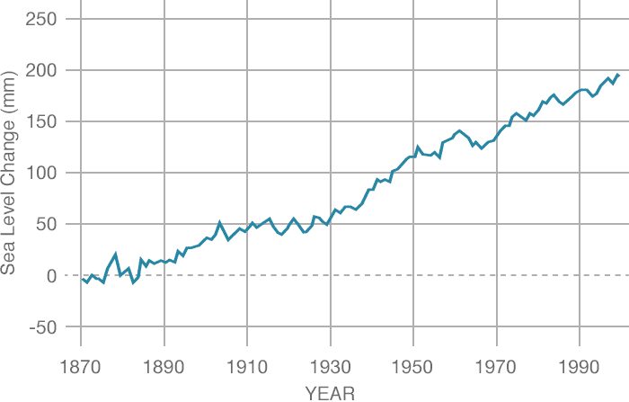
Sea Level rising

Slide 31
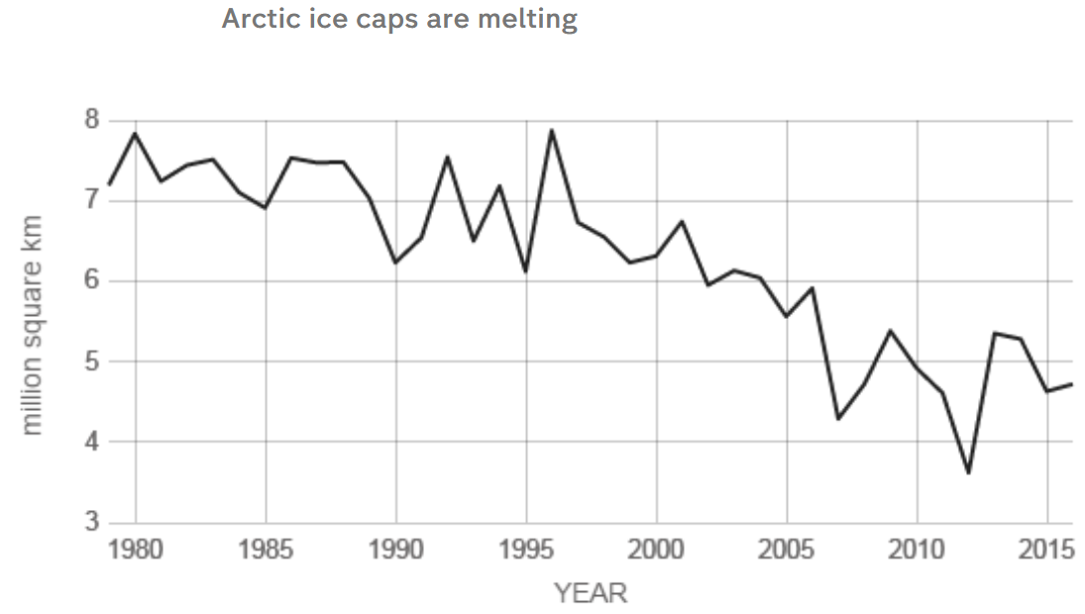
Arctic ice caps are melting

Slide 32

Mountain snow

Slide 33
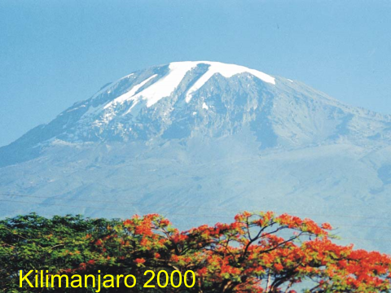
Mountain snow

Slide 34
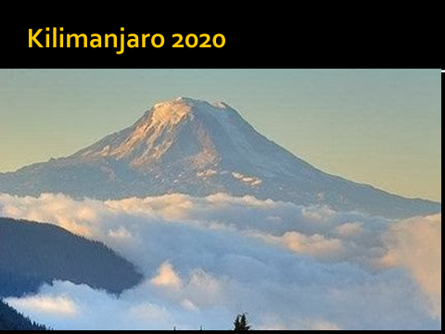
Mountain snow

Slide 35
The 2022 report of the Lancet Countdown on health and climate change: health at the mercy of fossil fuels
Because of human activity, the global mean surface temperature is 1·1°C higher than the pre-industrial average, and the past seven years were the warmest on record.
The 2022 report of the Lancet Countdown on health and climate change: health at the mercy of fossil fuels.Romanello M, Di Napoli C, Drummond P, Green C, Kennard H, Lampard P et al. October 25, 2022 DOI: https://doi.org/10.1016/S0140-6736(22)01540-9

Slide 36
Introduction
More recently, concerns about the health impact of changes in climate and ecosystems have been raised.
Global sea level rose about 8 inches (20 centimeters) in the last century. The rate in the last two decades, however, is nearly double .

Slide 37
Climate change: How does it affect us?
Climate change may affect our health and wellbeing through the impacts of extreme weather and weather-related events, resulting in severe damage to the natural and social systems on which health depends.
extreme events,
worsening air quality,
changes in the spread of infectious diseases,
threats to food and water quality and quantity
effects on our mental health.
Lancet planetary health: Global regional &national burden of mortality associated with non optimal ambient temperature from 2000~2019: 3stage modelling study

Slide 38
Who is most at risk of health effects due to climate change?
Children are vulnerable for several reasons. For example, children are more susceptible to heat stress and dehydration and are more sensitive to exposure to air pollution and smoke from bushfires.
Pregnant women are at increased risk of heat stress during heatwaves due to the physiological demands of pregnancy.
Older people and people with pre-existing medical conditions are more prone to dehydration, heat stress, infections and exacerbation of heart and lung disease.
People living in rural and remote areas, Aboriginal and Torres Strait Islander people, people on low incomes and other vulnerable populations are also at increased risk, in part due to inequalities in underlying health outcomes

Slide 39
The indicators of the 2022 report of the Lancet Countdown
Health hazards, exposures, and impacts
Health and heat
Exposure to warming
Heat and physical activity
Change in labour capacity
Heat-related mortality
Heat and Extreme weather Events

Slide 40

Health and Heat
Climate change is leading to an increase in average global temperatures and in the frequency, intensity, and duration of heatwaves.
Exposure to extreme heat is associated with acute kidney injury, heatstroke, adverse pregnancy outcomes worsened sleep patterns.
Impacts on mental health, worsening of underlying cardiovascular and respiratory disease, and increases in non-accidental and injury-related deaths.

Slide 41
Heat and physical activity
Heat and physical activity—headline finding: over the past 10 years, high heat posed at least a moderate heat stress risk during light outdoor physical activity, for an average additional 281 hours on per person per year, compared with 1991–2000

Slide 42
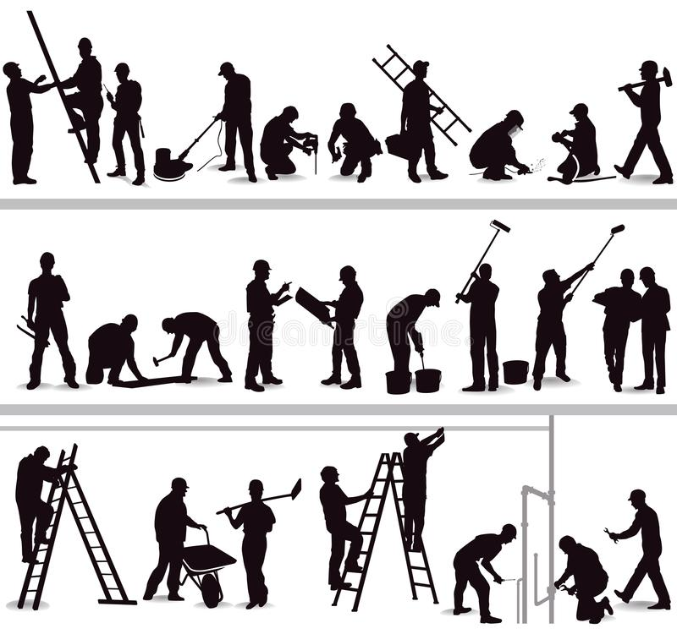
Change in labour capacity
Change in labour capacity—headline finding: in 2021, heat exposure led to the loss of 470 billion potential labour hours, a 37% increase from the period 1990–99. 87% of the losses in low HDI countries were in the agricultural sector.
Heat exposure affects labour productivity and puts the health of exposed workers at risk. The resulting labour loss undermines livelihoods and the socioeconomic determinants of health.

Slide 43
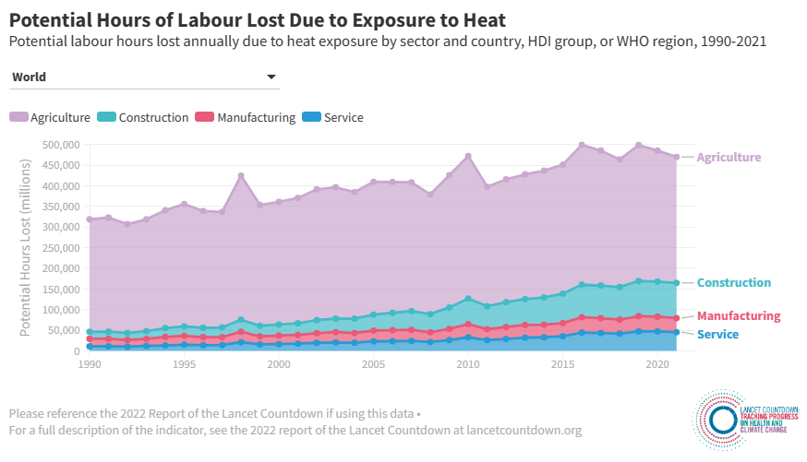
Potential hours of labour loss

Slide 44
Heat-related mortality
Heat-related mortality—headline finding: heat-related mortality for people older than 65 years increased by approximately 68% between 2000–04 and 2017–21
A study of 43 countries published in May, 2021, estimated that 37% of heat-related deaths are attributable to human-induced climate change.

Slide 45
health and extreme weather events
Wildfires
Drought
Extreme weather and sentiment

Slide 46
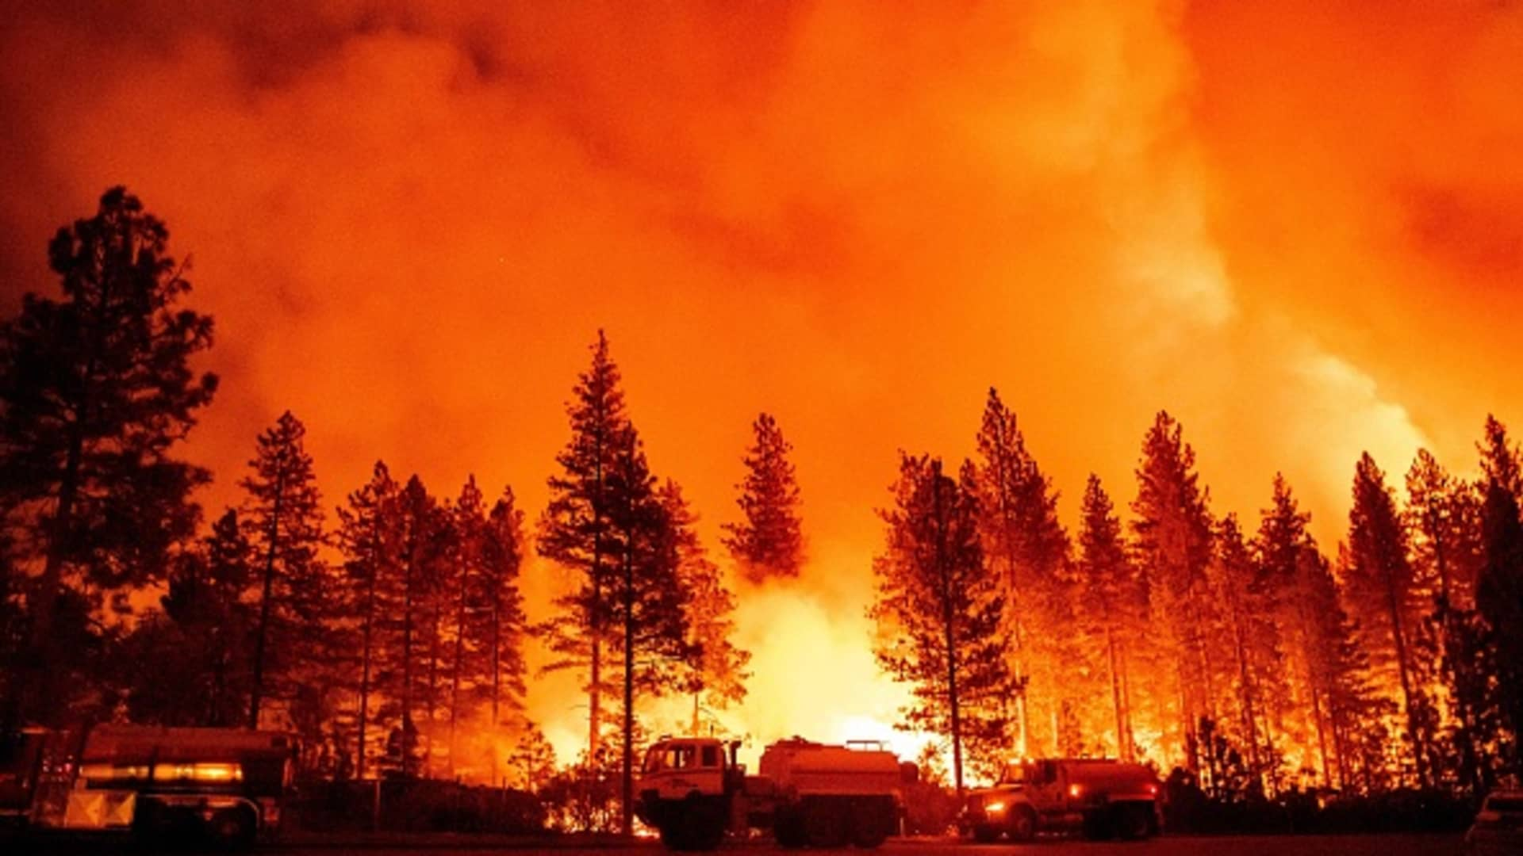
WILDFIRES
Wildfires—headline finding: Human exposure to days of very-high or extremely-high fire danger increased in 61% of countries from 2001–04 to 2018–21
Wildfires affect health with thermal injuries, exposure to wildfire smoke, loss of physical infrastructure, and impacts on mental health and wellbeing.
Globally, people experienced an average of nine more days of very-high or extremely-high meteorological wildfire danger in 2018–21 compared with 2001–04, caused by climate variation rather than demographic shifts.

Slide 47
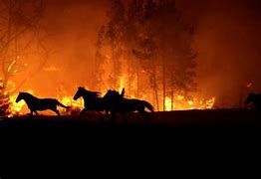
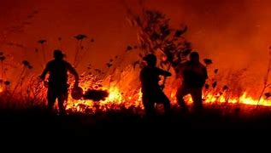
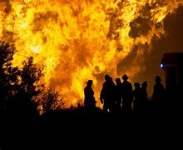
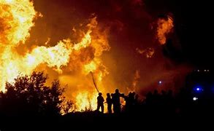

Slide 48
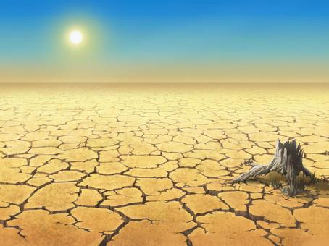
Drought
On average, 29% more global land area was affected by extreme drought for at least one month in a year in 2012–21 than in 1951–60
Droughts put food and water security at risk, threaten sanitation, affect livelihoods, and increase the risk of wildfires and infectious disease transmission.
In the period 2012–21, on average, almost 47% of global land area was affected by at least 1 month of extreme drought each year, an increase of 29% from the period 1951–60. The Middle East and north Africa, where 41 million people lack access to safe water and 66 million do not have basic sanitation services.

Slide 49
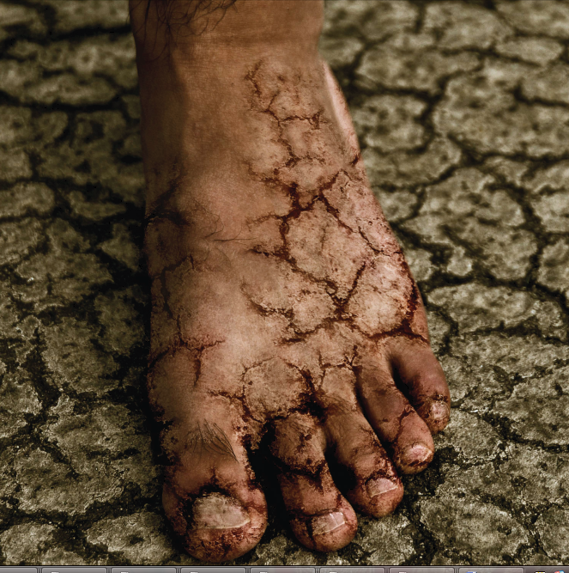

Slide 50
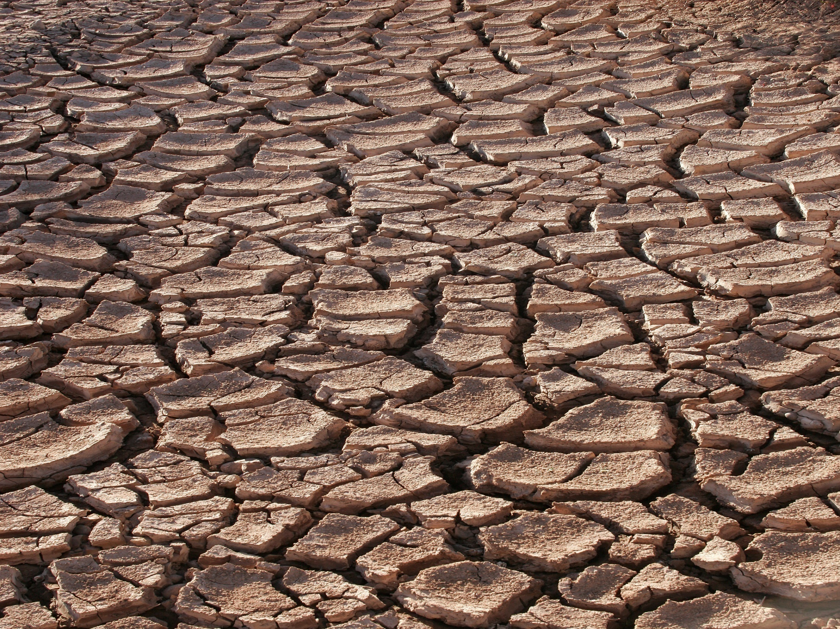

Slide 51
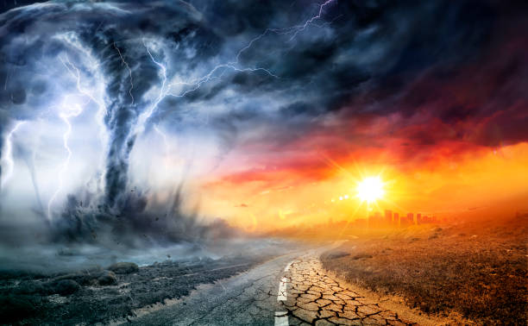
Extreme weather
Acute temperature increase, heatwaves, and humidity have been associated with worsened mental health outcomes and increased suicidality.
Young people have been shown to be more prone to anxiety, phobias, depression, stress-related conditions, substance abuse, sleep disorders.
Through indirect pathways, hazards such as droughts and heavy snow fall can disrupt agricultural production, affect livelihoods, and cause food and water scarcity.

Slide 52
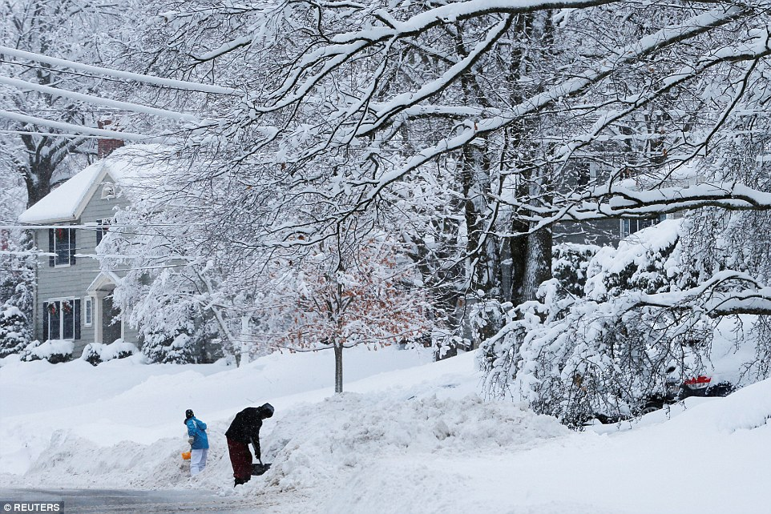
HEAVY SNOWFALL (BOMB CYCLONE) 2022

Slide 53

Cyclone / Tornedo

Slide 54

Katrina cost as much as four years of war:
$250 BILLION
Notes:
Ocean warming drives hurricanes.
Difficult to say that Katrina is a climate change event but there is no doubt that frequency of such extreme events is increasing and some are new:
In 2004 the first hurricane ever formed in the South Atlantic, and Cyclone GAFILO was the most powerful storm in the INDIAN Ocean.
http://en.wikipedia.org/wiki/Cyclone_Gafilo

Slide 55
Climate change: gradual change + sudden events
Flooding, windstorms
Vector-borne diseases
Foodborne disease
Waterborne disease
Direct effects of rising temperatures
Changes in air pollution
Notes:
Scoping studies:
UKCIP launched in 1997 to help co-ordinate scientific research into the impacts of climate change, and to help organisations adapt to those unavoidable impacts
In order to determine the impacts of climate change, scoping studies have been produced for most regions.
More specifically for the health sector, quantitative estimates of the possible impacts of climate change on health in the

Slide 56

Land and climate related hazards
Common in both lowland coastal and inland areas, especially in Tropics and monsoon areas

Slide 57

Flood in California, usa 2022

Slide 58


Slide 59

Land and climate related hazards
STORMS AND
HURRICANES

Slide 60


Slide 61


Slide 62

Land and climate related hazards
SOIL EROSION/ LANDSLIDE

Slide 63


Slide 64


Slide 65

Air Pollution
Land and climate related hazards

Slide 66

Air Pollution

Slide 67

Air Pollution
Air Pollution

Slide 68

Air Quality change and potential Hazards

Slide 69
Climate suitability for infectious disease transmission
Climate change is affecting the distribution and transmission of many infectious diseases, including
vector-borne,
food-borne,
waterborne diseases. Infectious diseases that are a public health concern.
With the increased movement of people and goods, urbanisation, and climate change, Aedes-transmitted arboviruses spread rapidly in the past two decades, and half the world population now lives in countries where dengue is present.

Slide 70
Climate suitability for infectious disease transmission
Combining data on temperature, rainfall, and population, this indicator tracks the basic reproduction number (R0) for dengue, Zika, and chikungunya as a proxy for their transmissibility and, new to this report, the number of months suitable for their transmission.
On average, during 2012–21, the R0 increased by 11·5% for the transmission of dengue by Aedes aegypti,12·0% for the transmission of chikungunya, 12·4% for the transmission of Zika compared with 1951–60, globally . During the same period, the length of the transmission season increased for all arboviruses by approximately 6%.

Slide 71


Slide 72

Change in climate suitability for infectious diseases

Slide 73
relationship of temp. & rh with malaria parasite and mosquito development
10 11 12 13
Minimum temp. for
parasite development
Optimum
temp.
Maximum temp.
for mosquito
survival
14 15 16 17 18 19
25 26 27
40 ºC
Relative Humidity 40 60 70 80

Slide 74
Water and Food-borne Disease:
Climate-Susceptible Pathogens
 | Rising temperatures | Increasing rainfall | Shifts in reservoir ranges | Sea level changes
Salmonella | X | X | X
Campylobacter | X | X | X
Vibrio | X | X |  | X
Leptospira | X | X
Enteroviruses | X | X
Naergleria fowleri | X
Cryptosporidium | X | X
Giardia | X | X

Slide 75


Slide 76

FOOD SECURITY AND
UNDERNUTRITION

Slide 77

Climate change and food insecurity
Shortened crop growth seasons globally associated with 98 million more people reporting moderate to severe food insecurity in 2020.
Food insecurity is increasing globally, with 720–811 million people hungry in 2020.
with the number of undernourished people increasing by 161 million to 720–811 million between 2019 and 2020.
This could result in an additional 7·6–13·1 million people undernourished globally in 2022.

Slide 78

Food availability, access, and stability
Climate change is putting food production, supply chains, and access at risk.
Rising temperatures are reducing crop growth duration in many countries, posing a threat to crop yields.
The increasing intensity and frequency of extreme weather events
heatwaves,
droughts,
wildfires, can damage crops and agricultural lands, affect livestock, disrupt supply chains, and affect food availability and stability of supplies

Slide 79

Food use and malnutrition
Diarrhoeal diseases are the leading cause of malnutrition in children younger than 5 years,
while other infections can severely affect nutrient absorption and utilisation.
Climate change therefore increases the risk of malnutrition by increasing the transmission risk of many infectious diseases, such as malaria, dengue, and vibriosis,
Increasing incidence of floods, droughts, and other extreme events affects sanitation and disease outbreaks.

Slide 80
Key findings of the 2022 report of the Lancet Countdown
Climate change is undermining every dimension of global health monitored, increasing the fragility of the global systems that health depends on.
Climate change is increasingly undermining global food security, exacerbating the effects of the COVID-19, geopolitical, energy, and cost-of-living crises.
New analysis of 103 countries shows that days of extreme heat, increasing in frequency and intensity due to climate change, accounted for an estimated 98 million more people reporting moderate to severe food insecurity in 2020 than the average in 1981–2010.

Slide 81
Climate change affects the social and environmental determinants of health – Clean Air, Safe Drinking Water, Sufficient Food And Secure Shelter
Between 2030 and 2050, climate change is expected to cause approximately 250,000 additional deaths per year, from malnutrition, malaria, diarrhoea and heat stress.
Climate change and health, WHO
30 October 2021

Slide 82
Conclusion
The direct damage costs to health is estimated to be between USD 2-4 billion/year by 2030.
Areas with weak health infrastructure – mostly in developing countries – will be the least able to cope without assistance to prepare and respond.
Reducing emissions of greenhouse gases through better transport, food and energy-use choices can result in improved health, particularly through reduced air pollution.
There are things we can all do now to build our resilience to the effects of climate change and help slow its pace.

Slide 83


Slide 84


Slide 85


Slide 86


Slide 87

LET’S SAVE THE ONLY WORLD WE HAVE

Slide 88

Dr. Refaya Tasnim

Slide 89

SOURCES
who.int.net
cdc.com
Lancet countdown.org 2022
Our World in Data
COP-27

Slide 90


